Slide 1
LLM4TS
Ching Chang

Slide 2
Outline
Method Design
How to deal with time-series data
PEFT
Experiments

Slide 3
Method Design – How to deal with time-series data

Slide 4
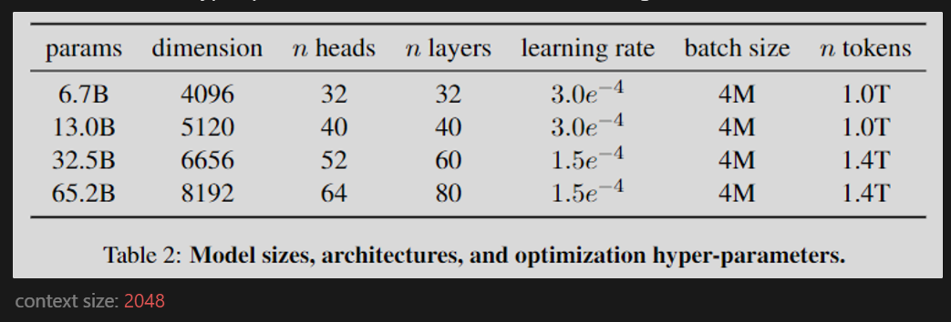
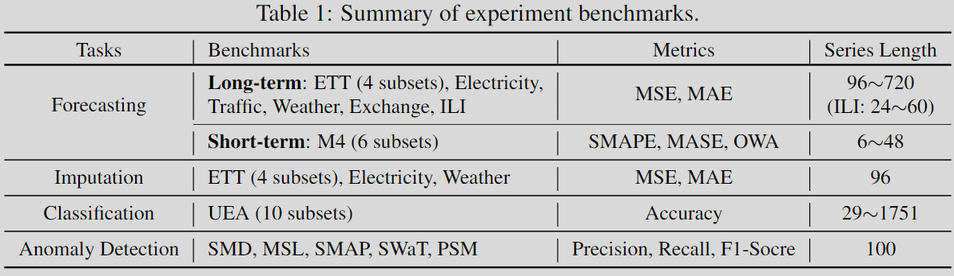
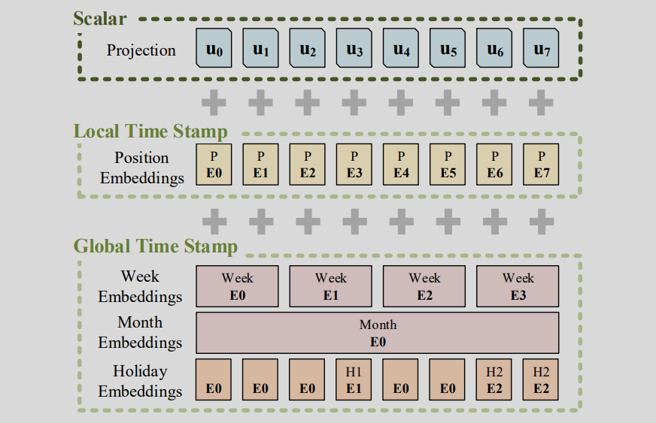
Outline
RevIN [RevIN]
Patching + Channel-Independence [PatchTST]
Or we can just treat (B, T, C) as (B, block_size, d_model)
Token Encoding
Linear [FPT]
Conv1D [Informer]
Positional Encoding [FPT]
(RoPE is not trainable unless freqs = nn.Parameter)
Temporal Embedding [Informer]

Slide 5




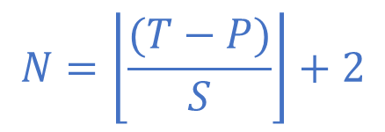





1. Patching
3.
(B, C, T_{P}, P)
B’
(w/ Channel Independence)
…
$$T$$
…
$$C$$
$$N$$
$$=T_{P}$$
2.
$$N$$
…
$$P$$
$$S$$
…
$$P$$
4.
Encoding (token + pos)
Linear/
Conv1D
$$N=\left\lfloor \frac{(T−P)}{S}\right\rfloor +2$$
1.
It won’t be larger than $S$
…
$$D$$

Slide 6

2. Feed Directly
$$T$$
$$C$$
Encoding (token + pos)
Linear/
Conv1D
…
$$D$$

Slide 7



3. Patching with Temporal Embedding
(w/ Channel Independence)
$$T$$
$$C$$
“Feed Directly” with Temporal Embedding
$$N$$
$$=T_{P}$$
1
2
.
.
16
9
10
.
.
24
17
18
.
.
32
…
$$P$$
For each position, we have multiple timestamps.
We need to devise a method to aggregate this temporal information.

Slide 8
How do we use temporal embedding?
Feed Directly vs. Patching
token
token
encoding
token_emb
token
patching
patched_token
token
encoding
token_emb
+
+
pos
pos
encoding
pos_emb
patched_pos
pos
encoding
pos_emb
temp
temp
encoding
temp_emb
patched_temp
temp
encoding
temp_emb

Slide 9
Method Design – PEFT

Slide 10
Outline
Gating with Adapter, Prefix-tuning, LoRA [UniPELT]
Gating → Zero-init Attention [LLaMA-Adapter V1]
Prefix-tuning with real virtual tokens [LLaMA-Adapter V1]
Norm Tuning [LLaMA-Adapter V2, FPT]
Linear Tuning [LLaMA-Adapter V2]

Slide 11
FPT vs. TSAdapter
use_amp=True
Methods | GPT4TS | GPT2_TSAdapter
Patching + C-I | V | Patching/Feed Directly
Token Embedding | Linear | Linear/Conv1D
Positional Embedding | V | V
Temporal Embedding |  | V
RevIN | V | V
Norm Tuning | V | V
Linear Tuning |  | V
Adapter |  | V
Prefix-Tuning |  | V
LoRA |  | V

Slide 12
Experiments

Slide 13
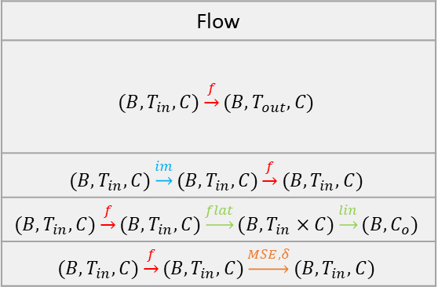
5 Tasks
Flow
$$(B,T_{in},C)\underset{→}{f}(B,T_{out},C)$$
$$(B,T_{in},C)\underset{→}{im}(B,T_{in},C)\underset{→}{f}(B,T_{in},C)$$
$$(B,T_{in},C)\underset{→}{f}(B,T_{in},C)\underset{→}{flat}(B,T_{in}×C)\underset{→}{lin}(B, C_{o})$$
$$(B,T_{in},C)\underset{→}{f}(B,T_{in},C)\underset{→}{MSE, δ}(B,T_{in},C)$$

Slide 14
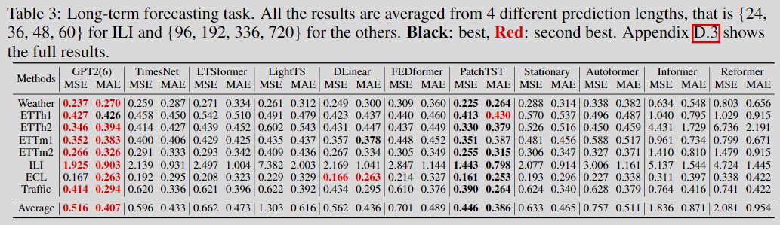
Long-term Forecasting
LLaMA-TSAdapter(?)
MSE MAE
0.000
0.000
0.000
0.000
0.000
0.000
0.000
0.000
0.000
0.000
0.000
0.000
0.000
0.000
0.000
0.000
0.000
0.000

Slide 15
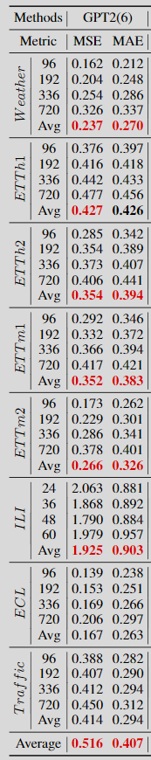
Long-term Forecasting
Methods | LLaMA-TSAdapter 96 |  | LLaMA-TSAdapter 192 |  | LLaMA-TSAdapter 336 |  | LLaMA-TSAdapter 720 |  | LLaMA-TSAdapter Average |  | GPT4TS 96 |  | GPT4TS 192 |  | GPT4TS 336 |  | GPT4TS 720 |  | GPT4TS Average
Weather |  |  |  |  |  |  |  |  |  |  | 0.148 | 0.196 | 0.194 | 0.24 | 0.248 | 0.282 | 0.317 | 0.332 | 0.227 | 0.263
ETTh1 |  |  |  |  |  |  |  |  |  |  | 0.384 | 0.407 | 0.415 | 0.426 | 0.43 | 0.439 | 0.427 | 0.454 | 0.414 | 0.432
ETTh2
ETTm1
ETTm2
ECL
Traffic
Methods | LLaMA-TSAdapter 24 |  | LLaMA-TSAdapter 36 |  | LLaMA-TSAdapter 48 |  | LLaMA-TSAdapter 60 |  | LLaMA-TSAdapter Average |  | GPT4TS 24 |  | GPT4TS 36 |  | GPT4TS 48 |  | GPT4TS 60 |  | GPT4TS Average
ILI

Slide 16
Time-Series XXX – Problem Definition
Baseline
…
GPT2-FFT
GPT2-FPT
GPT2-TSAdapter
LLaMA-FFT
LLaMA-FPT
LLaMA-TSAdapter
Dataset
…

Slide 17
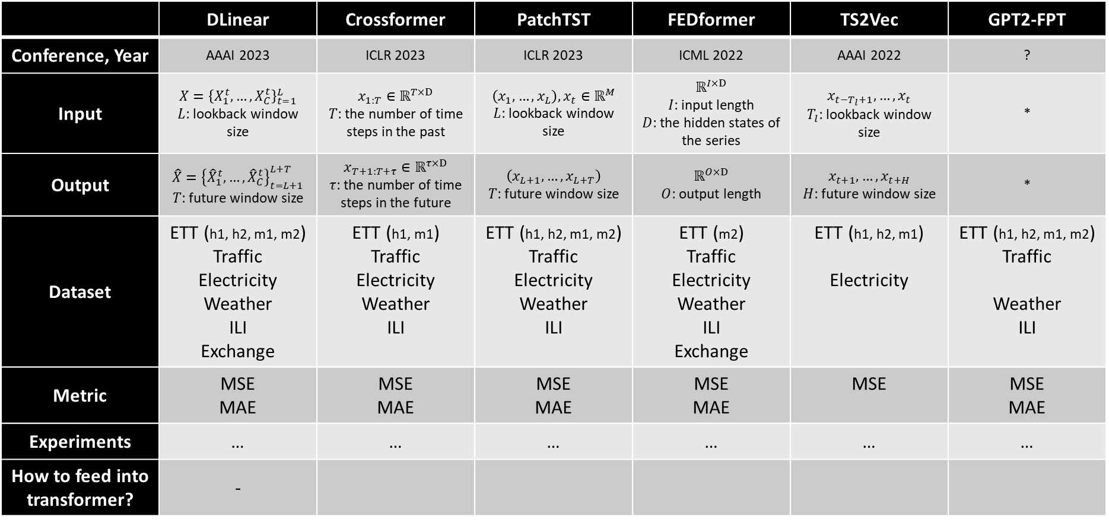
Time-Series Forecasting – SOTA Papers
Train/val/test sets are zero-mean normalized with the mean and std of training set.
 | DLinear | Crossformer | PatchTST | FEDformer | TS2Vec | GPT2-FPT
Conference, Year | AAAI 2023 | ICLR 2023 | ICLR 2023 | ICML 2022 | AAAI 2022 | ?
Input | $$X={\left\{X_{1}^{t}, …,X_{C}^{t}\right\}}_{t=1}^{L}$$ $L$: lookback window size | $$x_{1:T}∈ℝ^{T×D}$$ $T$: the number of time steps in the past | $$\left(x_{1},…, x_{L}\right), x_{t}∈ℝ^{M}$$ $L$: lookback window size | $$ℝ^{I×D}$$ $I$: input length $D$: the hidden states of the series | $$x_{t−T_{l}+1},…,x_{t}$$ $T_{l}$: lookback window size | *
Output | $$\hat{X}={\left\{{\hat{X}}_{1}^{t}, …,{\hat{X}}_{C}^{t}\right\}}_{t=L+1}^{L+T}$$ $T$: future window size | $$x_{T+1:T+τ}∈ℝ^{τ×D}$$ $τ$: the number of time steps in the future | $$\left(x_{L+1},…, x_{L+T}\right)$$ $T$: future window size | $$ℝ^{O×D}$$ $O$: output length | $$x_{t+1},…,x_{t+H}$$ $H$: future window size | *
Dataset | ETT (h1, h2, m1, m2) Traffic Electricity Weather ILI Exchange | ETT (h1, m1) Traffic Electricity Weather ILI | ETT (h1, h2, m1, m2) Traffic Electricity Weather ILI | ETT (m2) Traffic Electricity Weather ILI Exchange | ETT (h1, h2, m1) Electricity | ETT (h1, h2, m1, m2) Traffic Weather ILI
Metric | MSE MAE | MSE MAE | MSE MAE | MSE MAE | MSE | MSE MAE
Experiments | … | … | … | … | … | …
How to feed into transformer? | -
*From GPT2-FPT:
Since DLinear and PatchTST have verified that channel-independence works in the above datasets, we directly treat multivariate series as univariate series.

Slide 18
Time-Series Classification – SOTA Papers
 | … | … | … | … | TS2Vec | GPT2-FPT
Conference, Year |  |  |  |  | AAAI 2022 | ?
Input
Output
Dataset
Metric
Experiments

Slide 19
Time-Series Anomaly Detection – SOTA Papers
 | GTN | TARNet | … | … | TS2Vec | GPT2-FPT
Conference, Year |  |  |  |  | AAAI 2022 | ?
Input
Output
Dataset
Metric
Experiments

Slide 20
Time-Series Forecasting

Slide 21
Baseline + Dataset
Baseline
PatchTST
DLinear
Crossformer
FEDformer
TS2Vec
GPT2-FFT
GPT2-FPT
GPT2-TSAdapter
LLaMA-FFT
LLaMA-FPT
LLaMA-TSAdapter
Dataset
ETT (h1, h2, m1, m2)
Traffic
Electricity
Weather
ILI

Slide 22
Full Data
Models |  | LLaMA-TSAdatper |  | GPT2-FPT |  | PatchTST |  | Dlinear |  | CrossFormer |  | FEDFormer |  | TS2Vec
Metric |  | MSE | MAE | MSE | MAE | MSE | MAE | MSE | MAE | MSE | MAE | MSE | MAE | MSE | MAE
Weather | 96 | 0.100 |  |  |  | 0.149 | 0.198 | 0.176 | 0.237 |  |  | 0.238 | 0.314
Experiments | 192 |  |  |  |  | 0.194 | 0.241 | 0.220 | 0.282 |  |  | 0.275 | 0.329
 | 336 |  |  |  |  | 0.245 | 0.282 | 0.265 | 0.319 |  |  | 0.339 | 0.377
 | 720 |  |  |  |  | 0.314 | 0.334 | 0.323 | 0.362 |  |  | 0.389 | 0.409
Traffic | 96 |  |  |  |  | 0.360 | 0.249 | 0.410 | 0.282 |  |  | 0.576 | 0.359
Experiments | 192 |  |  |  |  | 0.379 | 0.256 | 0.423 | 0.287 |  |  | 0.610 | 0.380
 | 336 |  |  |  |  | 0.392 | 0.264 | 0.436 | 0.296 |  |  | 0.608 | 0.375
 | 720 |  |  |  |  | 0.432 | 0.286 | 0.466 | 0.315 |  |  | 0.621 | 0.375
Electricity | 96 |  |  |  |  | 0.129 | 0.222 | 0.140 | 0.237 |  |  | 0.186 | 0.302
Experiments | 192 |  |  |  |  | 0.147 | 0.240 | 0.153 | 0.249 |  |  | 0.197 | 0.311
 | 336 |  |  |  |  | 0.163 | 0.259 | 0.169 | 0.267 |  |  | 0.213 | 0.328
 | 720 |  |  |  |  | 0.197 | 0.290 | 0.203 | 0.301 |  |  | 0.233 | 0.344
ILI | 24 |  |  |  |  | 1.319 | 0.754 | 2.215 | 1.081 |  |  | 2.624 | 1.095
Experiments | 36 |  |  |  |  | 1.579 | 0.870 | 1.963 | 0.963 |  |  | 2.516 | 1.021
 | 48 |  |  |  |  | 1.553 | 0.815 | 2.130 | 1.024 |  |  | 2.505 | 1.041
 | 60 |  |  |  |  | 1.470 | 0.788 | 2.368 | 1.096 |  |  | 2.742 | 1.122
ETTh1 | 96 |  |  |  |  | 0.370 | 0.400 | 0.375 | 0.399 |  |  | 0.376 | 0.415
Experiments | 192 |  |  |  |  | 0.413 | 0.429 | 0.405 | 0.416 |  |  | 0.423 | 0.446
 | 336 |  |  |  |  | 0.422 | 0.440 | 0.439 | 0.443 |  |  | 0.444 | 0.462
 | 720 |  |  |  |  | 0.447 | 0.468 | 0.472 | 0.490 |  |  | 0.469 | 0.492
ETTh2 | 96 |  |  |  |  | 0.274 | 0.337 | 0.289 | 0.353 |  |  | 0.332 | 0.374
Experiments | 192 |  |  |  |  | 0.341 | 0.382 | 0.383 | 0.418 |  |  | 0.407 | 0.446
 | 336 |  |  |  |  | 0.329 | 0.384 | 0.448 | 0.465 |  |  | 0.400 | 0.447
 | 720 |  |  |  |  | 0.379 | 0.422 | 0.605 | 0.551 |  |  | 0.412 | 0.469
ETTm1 | 96 |  |  |  |  | 0.293 | 0.346 | 0.299 | 0.343 |  |  | 0.326 | 0.390
Experiments | 192 |  |  |  |  | 0.333 | 0.370 | 0.335 | 0.365 |  |  | 0.365 | 0.415
 | 336 |  |  |  |  | 0.369 | 0.392 | 0.369 | 0.386 |  |  | 0.392 | 0.425
 | 720 |  |  |  |  | 0.416 | 0.420 | 0.425 | 0.421 |  |  | 0.446 | 0.458
ETTm2 | 24 |  |  |  |  | 0.166 | 0.256 | 0.167 | 0.260 |  |  | 0.180 | 0.271
Experiments | 36 |  |  |  |  | 0.223 | 0.296 | 0.224 | 0.303 |  |  | 0.252 | 0.318
 | 48 |  |  |  |  | 0.274 | 0.329 | 0.281 | 0.342 |  |  | 0.324 | 0.364
 | 60 |  |  |  |  | 0.362 | 0.385 | 0.397 | 0.421 |  |  | 0.410 | 0.420

Slide 23
Few shot learning (5%)
Models |  | LLaMA-TSAdatper |  | GPT2-FPT |  | PatchTST |  | Dlinear |  | CrossFormer |  | FEDFormer |  | TS2Vec
Metric |  | MSE | MAE | MSE | MAE | MSE | MAE | MSE | MAE | MSE | MAE | MSE | MAE | MSE | MAE
Weather | 96 | 0.100
Experiments | 192
 | 336
 | 720
Traffic | 96
Experiments | 192
 | 336
 | 720
Electricity | 96
Experiments | 192
 | 336
 | 720
ILI | 24
Experiments | 36
 | 48
 | 60
ETTh1 | 96
Experiments | 192
 | 336
 | 720
ETTh2 | 96
Experiments | 192
 | 336
 | 720
ETTm1 | 96
Experiments | 192
 | 336
 | 720
ETTm2 | 24
Experiments | 36
 | 48
 | 60

Slide 24
Time-Series Classification

Slide 25
Time-Series Anomaly Detection

